Slide 1

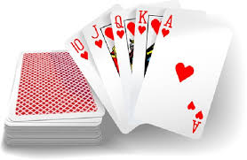
Sortable Poker Hand
Loading … 12%
Weekly demo
Arnold BARNA
2017-09-15

Slide 2

Sortable Poker Hand
French card: Described by rank and suit
Ranks: 2, 3, 4, 5, 6, 7, 8, 9, T(en), J(ack), Q(ueen), K(ing), A(ce)
Suits: S(pades), H(earts), D(iamonds), C(lubs)
Hand: Five valid cards you have in your hand

Slide 3
Valid inputs
Valid card: „<Rank><Suit>”
Acceptable: “2H” “td”
Not acceptable: “c9” “c99” “” etc
Valid hand: ”<card#1> <card#2> … <card#5>”
Acceptable: “KS 2H 5C JD TD”
Not acceptable: „KS 2H 5C JD” „KS2H5CJDTD” „KS,2H,5C,JD:TD” “KS KS 5C JD TD”

Slide 4
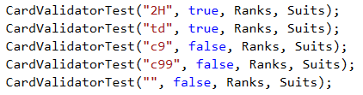
How do I know it works?

Slide 5
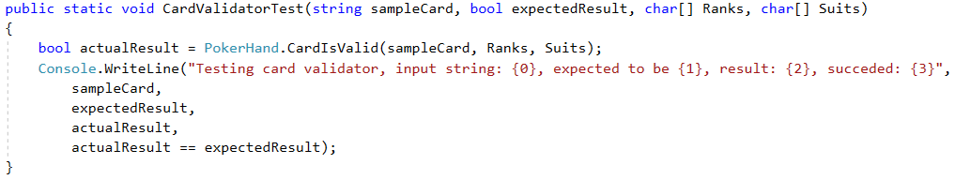

Test the card validator

Slide 6
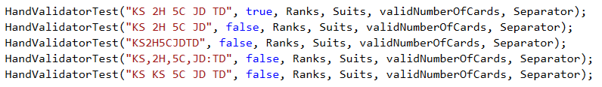
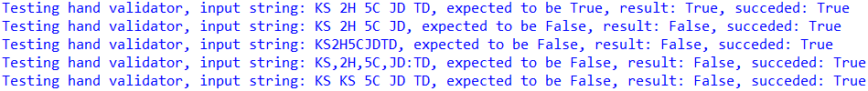
Hand validator

Slide 7

Sorting validator

Slide 8
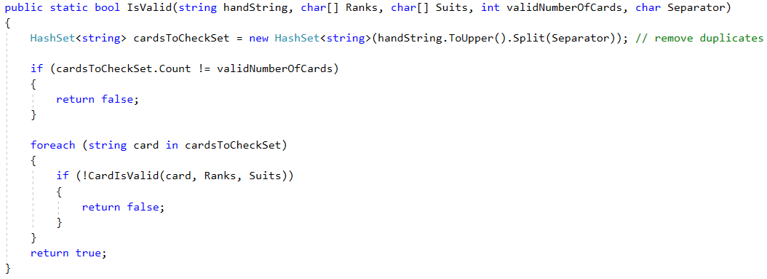
How to validate the hand?

Slide 9
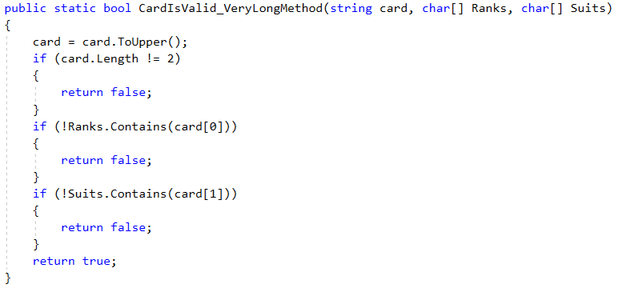
How to validate the card? Long way …

Slide 10
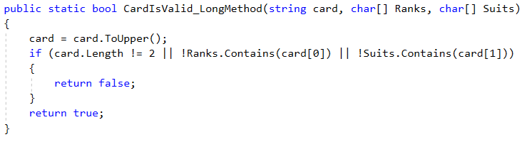
How to validate the card? Shorter way …

Slide 11
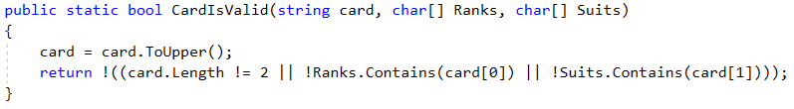
How to validate the card? Even shorter …

Slide 12
How to validate the card? Black belt …
λ

Slide 13
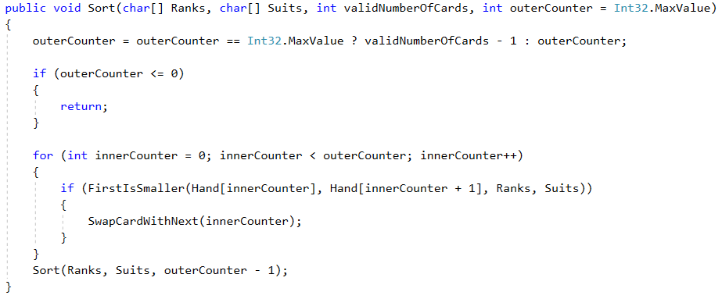
How to sort the hand recursively?

Slide 14
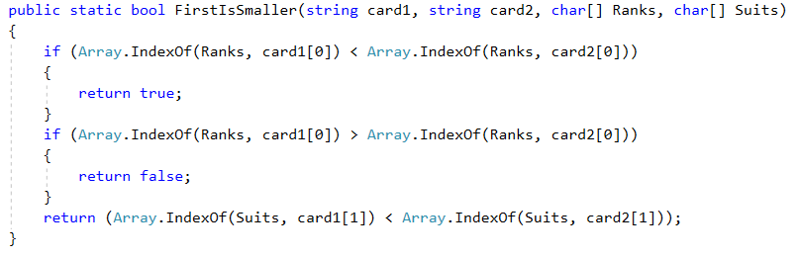
How to compare two cards?

Slide 15
Thank you for the attention
Available on GitHub:
Code:
https://github.com/greenfox-academy/bramble100/tree/master/week-02/SortablePokerHands
Slides:
https://github.com/greenfox-academy/bramble100/tree/master/week-02/demo

